Slide 1
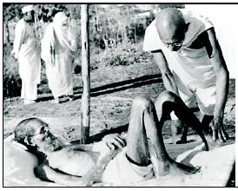
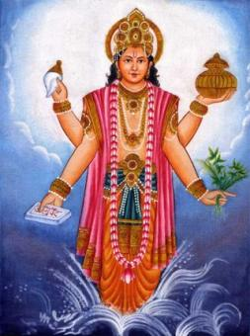

Welcomes You

Slide 2
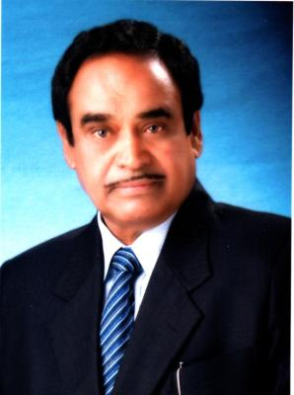
Our Inspiration
Late Hon’ble Dr.Rajendraji Gode
M.B.B.S.M.S.(Gen.Surg),Ex-Minister Home & Industry)
Founder President Indira Bahu-Uddeshiya Shikshan Sanstha,Buldana

Slide 3
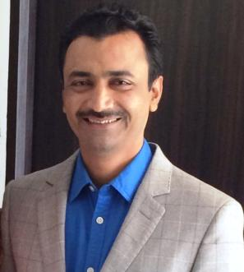
Hon’ble Mr.Yogendraji R. Gode
President
Indira Bahu-Uddeshiya Shikshan Sanstha,Buldana

Slide 4
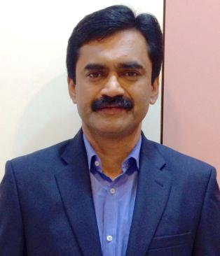
Hon’ble Dr.Yogeshji R. Gode
M.B.B.S.M.S.(Gen Surg)
Secretary
Indira Bahu-Uddeshiya Shikshan Sanstha,Buldana

Slide 5
DOCUMENTATION

Slide 6
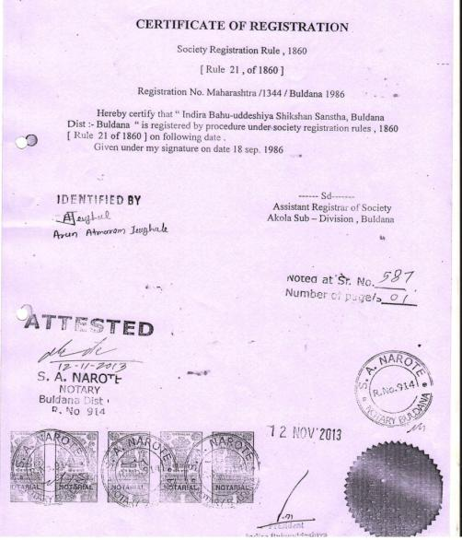
                Society Registration

Slide 7
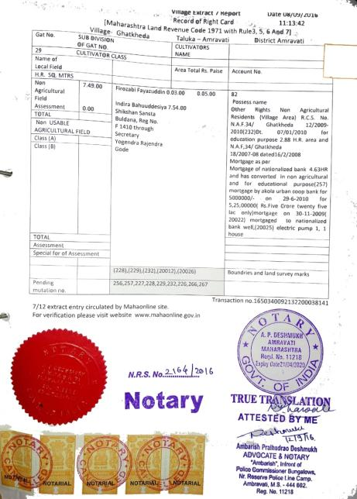
Land Documents

Slide 8
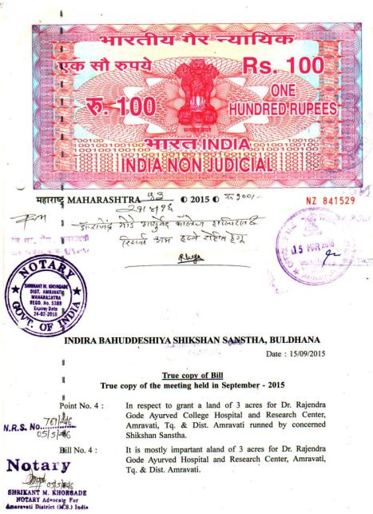
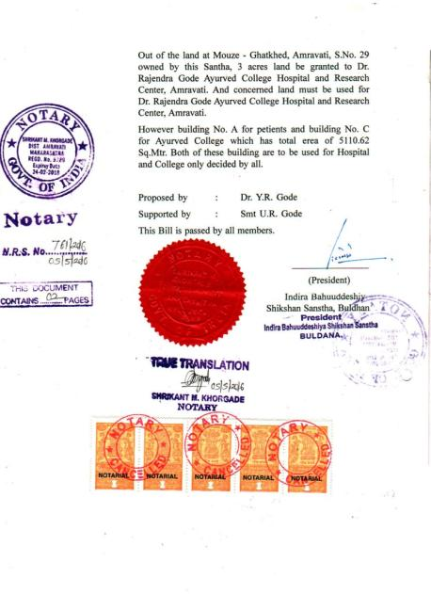
Lands Documents

Slide 9
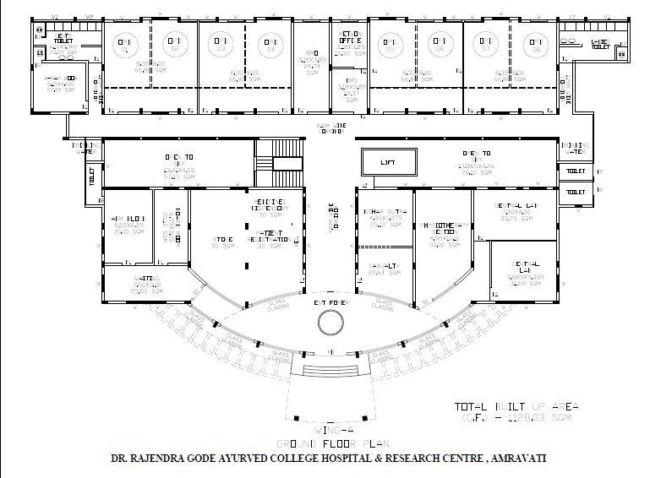
Hospital Building Map GF

Slide 10
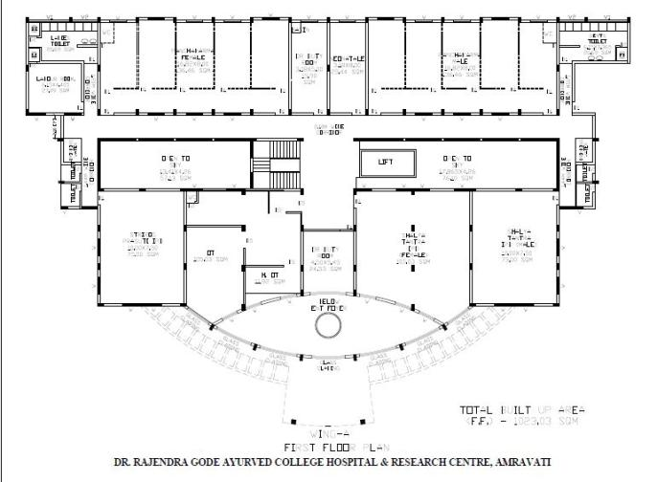
Hospital Building Map FF

Slide 11
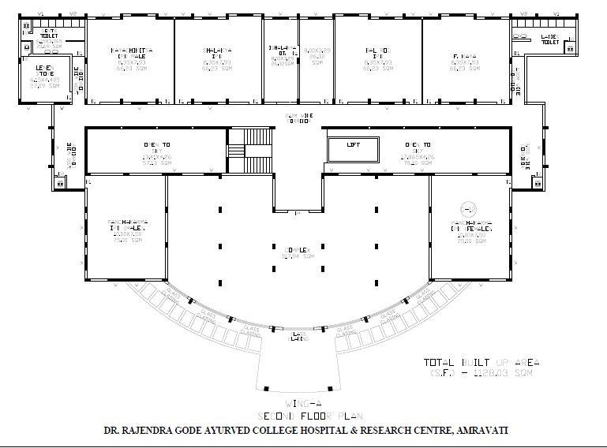
Hospital Building Map SF

Slide 12
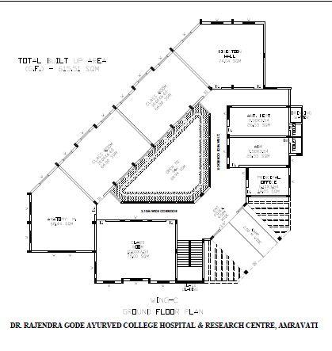
College Building Map GF

Slide 13
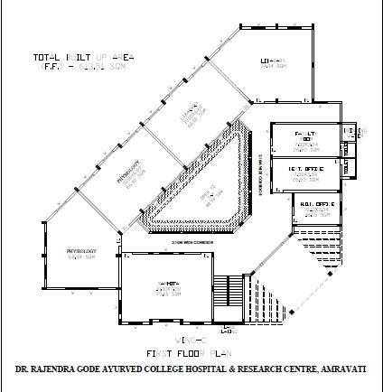
College Building Map FF

Slide 14
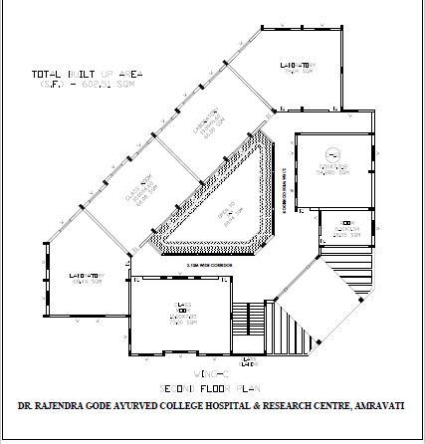
College Building Map SF

Slide 15
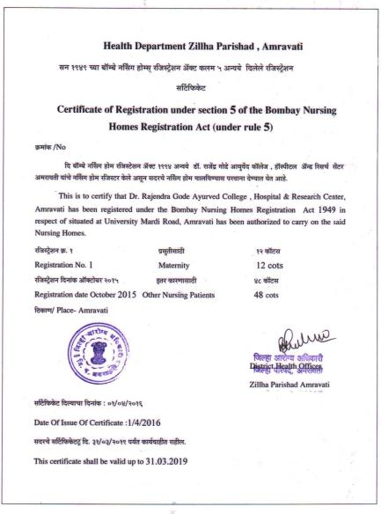
Hospital Ownership Certificate

Slide 16
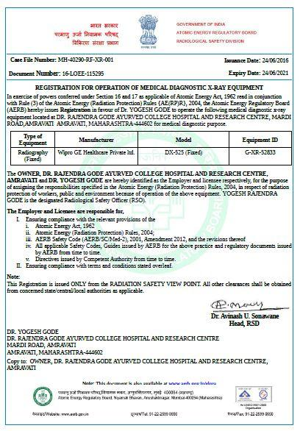
Atomic Energy Regulatory Board Certificate of X-Ray Unit

Slide 17
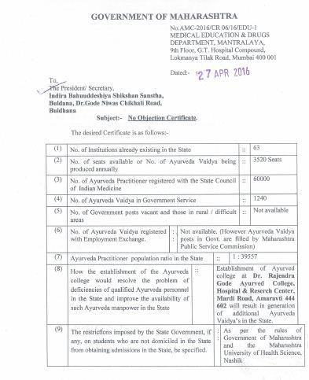
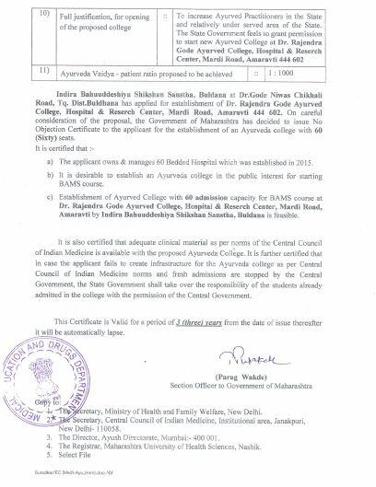
Govt. of Maharashtra NOC

Slide 18
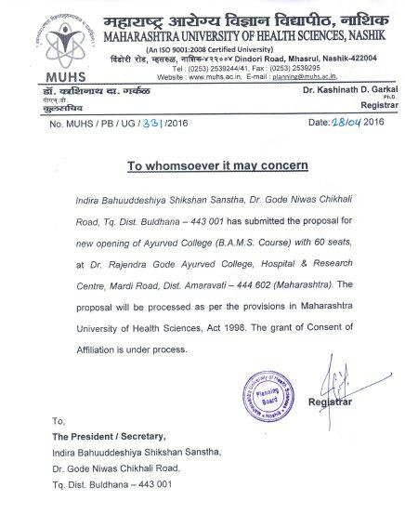
Consent Certificate by MUHS

Slide 19
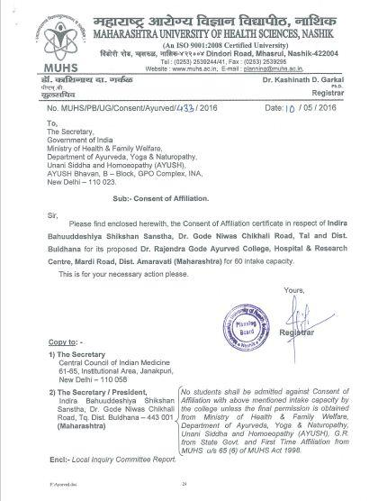
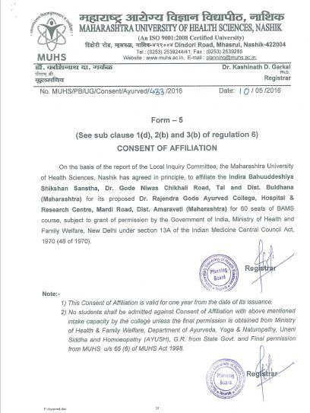
Consent of Affiliation by MUHS

Slide 20
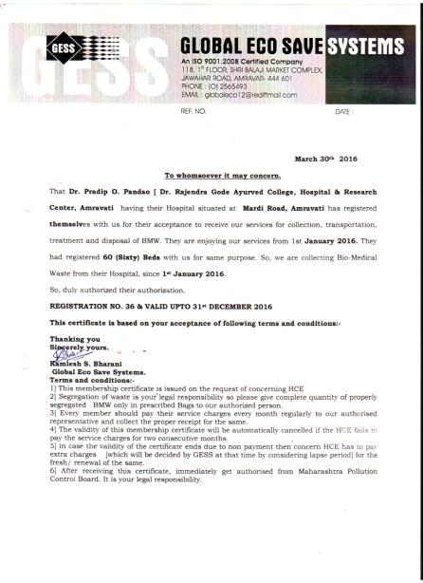
Biomedical Waste Registration

Slide 21
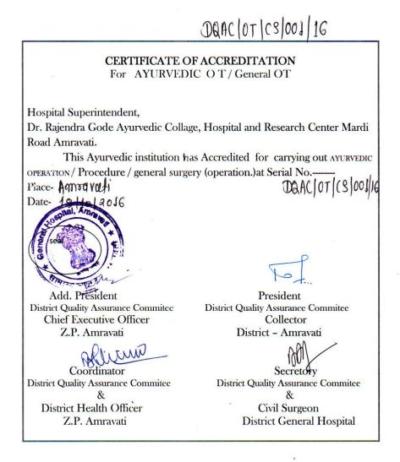
O.T. Permission

Slide 22
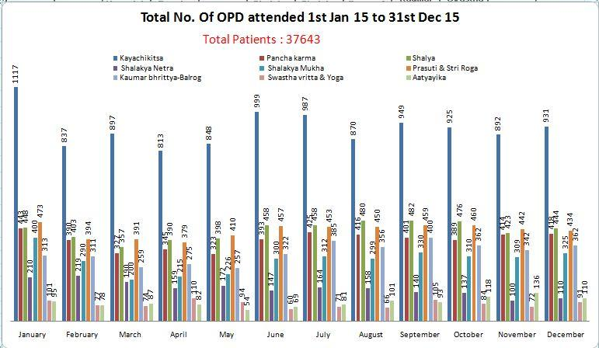
OPD data 1st Jan 15 to 31st Dec 15

Slide 23
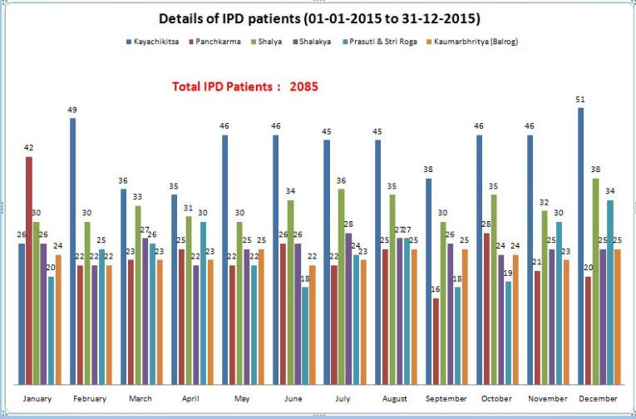
IPD Data 1st Jan 15 to 31st Dec 15

Slide 24
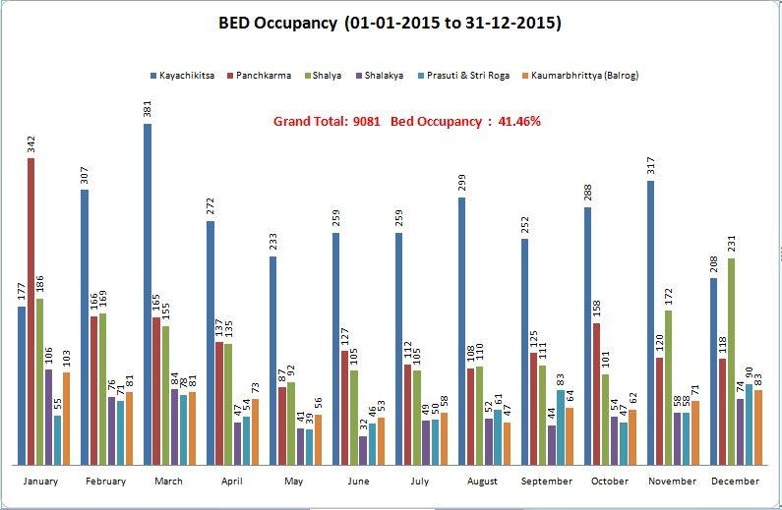
Bed Occupancy

Slide 25
Index
E-Library with 10 Computers and Internet facility
Library with 2225 books ( 2000 Ayurved and 225 Modern)
Acquaintance Roll Available
I-Cards Available
Biometric Machine Installed
Hospital & College Photos

Slide 26
HOSPITAL BUILDING PHOTOS

Slide 27
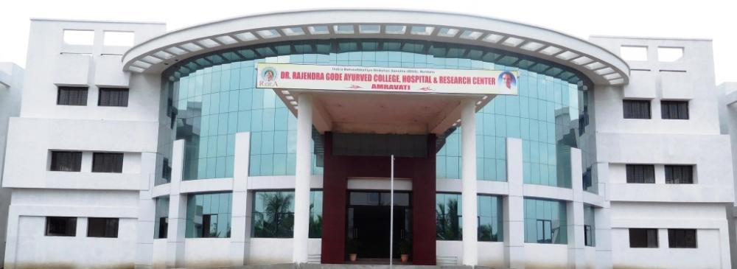
Hospital Building

Slide 28
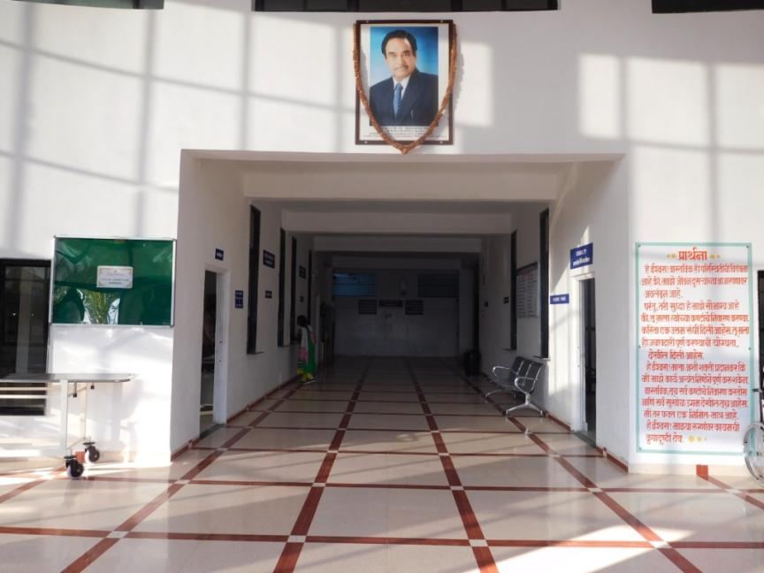
Entrance

Slide 29
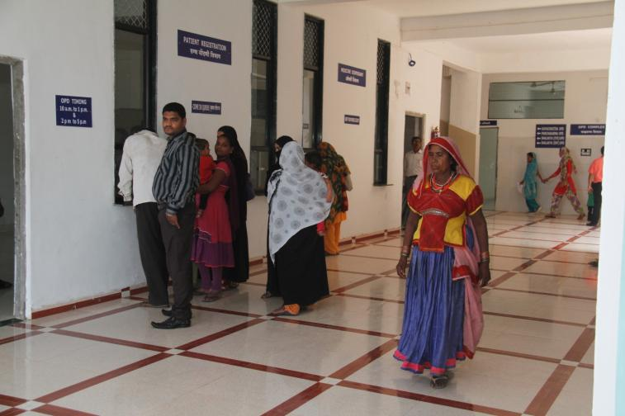
Patients Registration

Slide 30
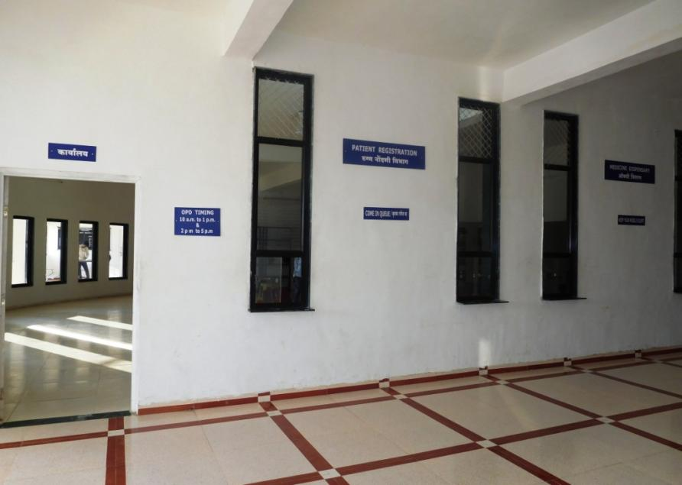
Medicine Dispense

Slide 31
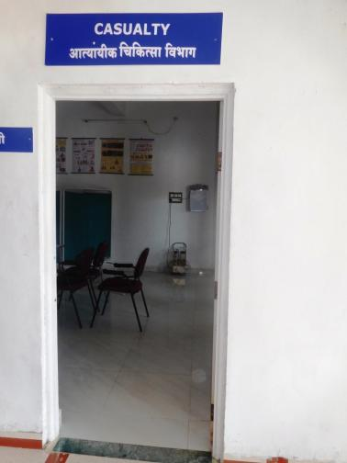
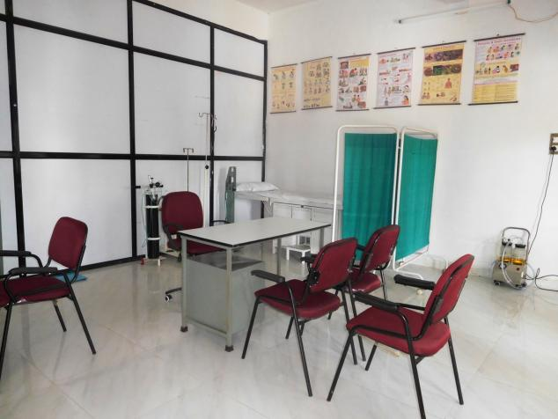
Casualty

Slide 32
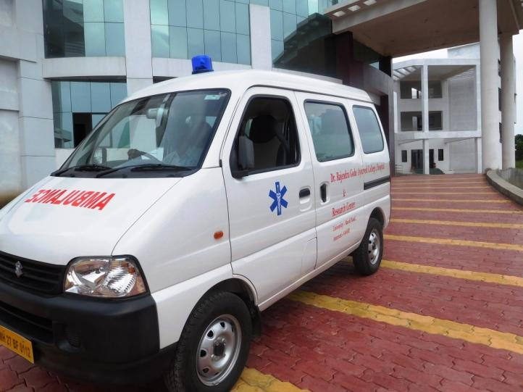
Ambulance

Slide 33
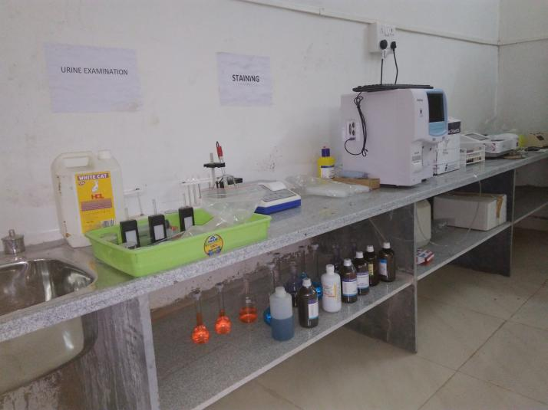
Central Laboratory

Slide 34
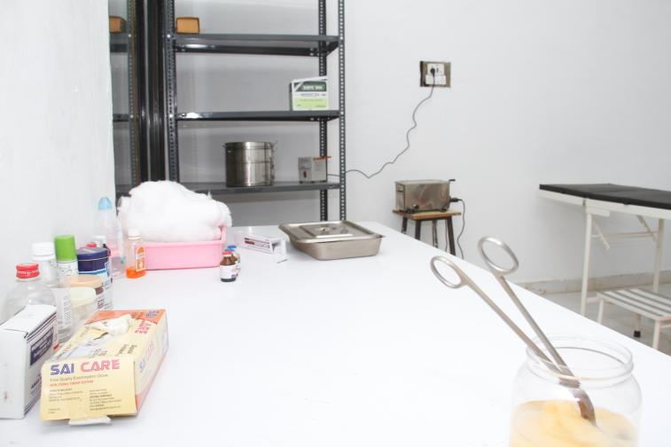
Ksharsutra Dressing Room

Slide 35
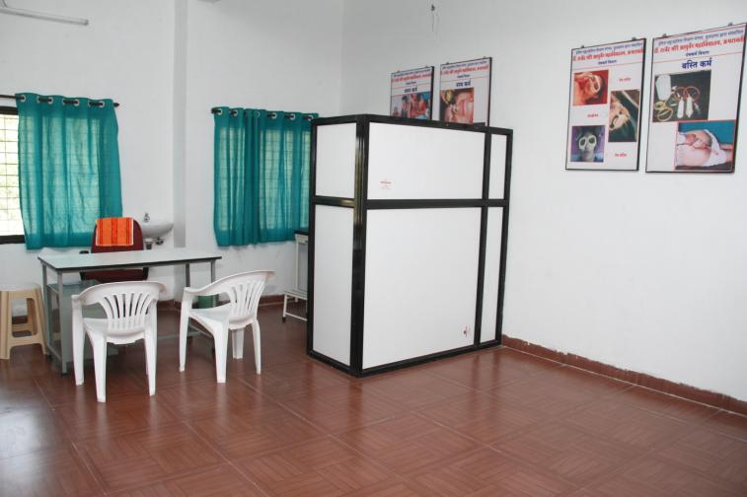
Out Patient Department

Slide 36
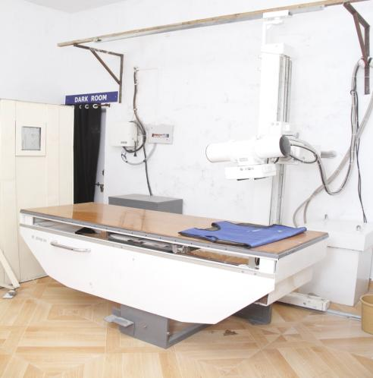
X- Ray Section

Slide 37
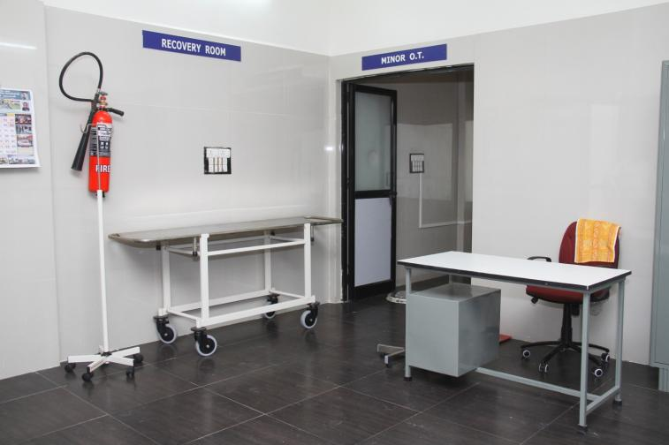
Recovery Room and Minor O.T

Slide 38
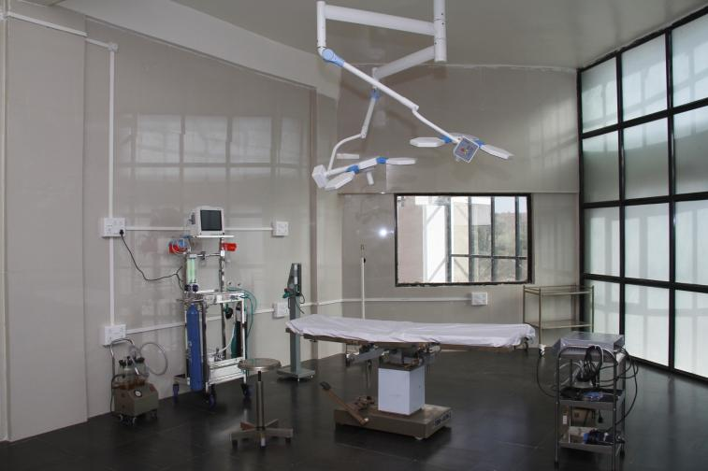
Major Operation Theater

Slide 39
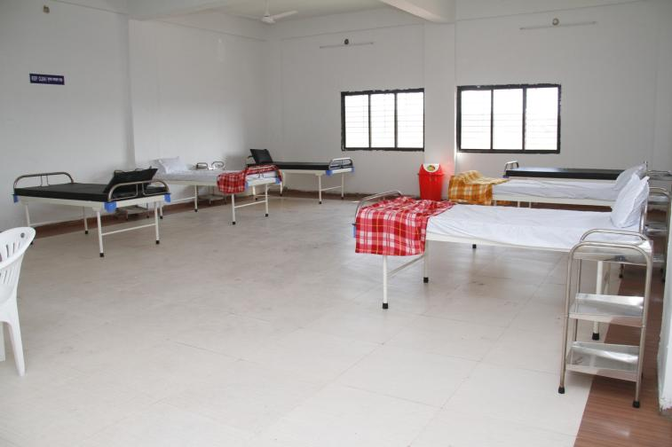
In Patient Department

Slide 40
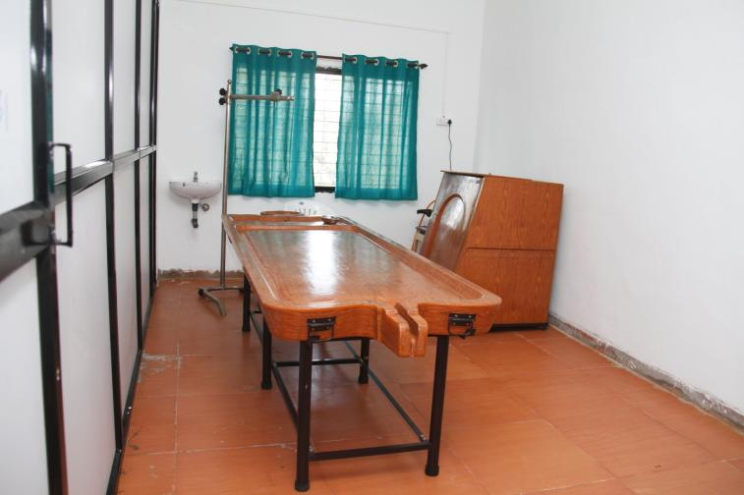
Snehan-Swedan Section

Slide 41
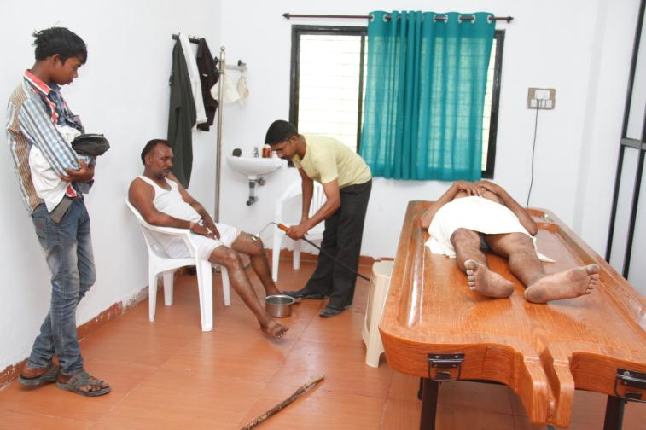
Snehan-Swedan Section

Slide 42
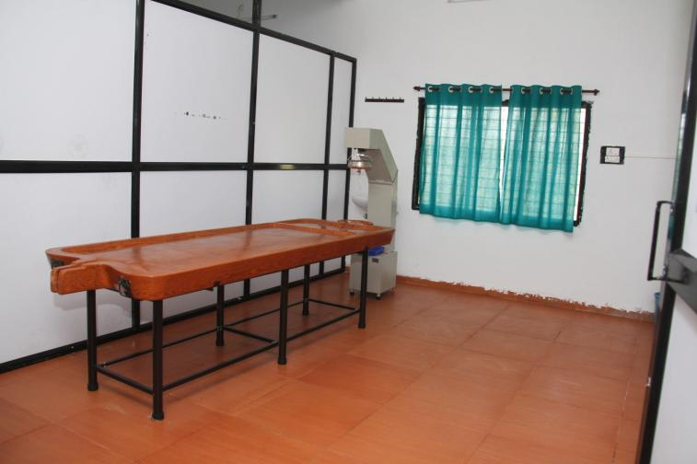
Shirodhara Section

Slide 43
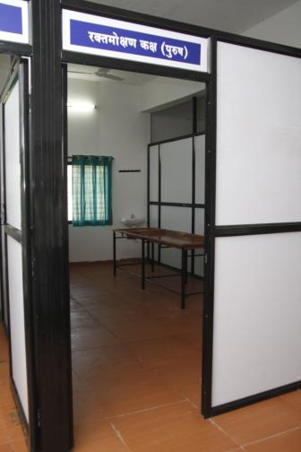
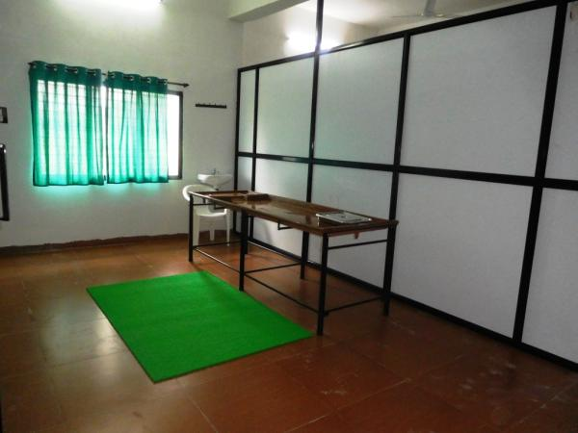
Raktamokshan Section

Slide 44
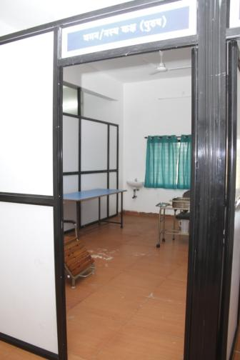
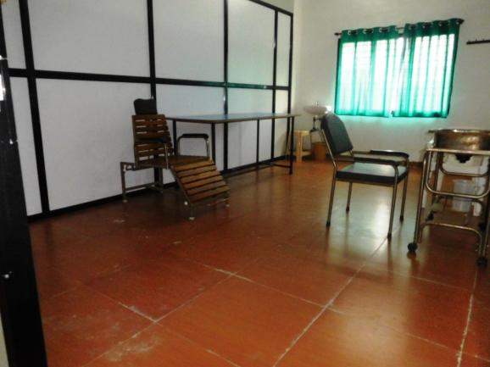
Vaman Section

Slide 45
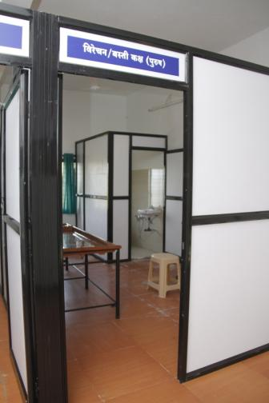
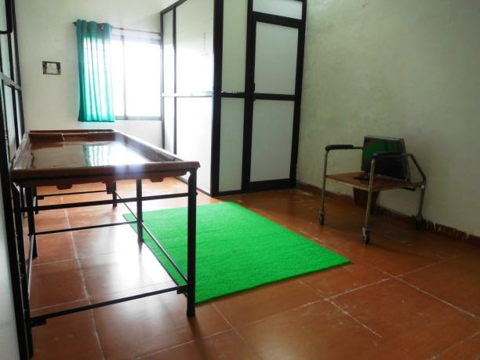
Virechan Section

Slide 46

Basti Section

Slide 47

Neonatal Care Room

Slide 48

Labour Room

Slide 49

Drinking Water

Slide 50

College Building

Slide 51

Class-Room

Slide 52

Sanskrit, Samhita,Siddhant

Slide 53

Anatomy Department

Slide 54

Anatomy Museum

Slide 55

Dissection Hall

Slide 56


Cadaver Room

Slide 57

Physiology Department

Slide 58

Physiology Laboratory

Slide 59

E-Library

Slide 60

Library

Slide 61

Reading Room

Slide 62

Herbal Garden

Slide 63

Boys Hostel

Slide 64

Girls Hostel

Slide 65

Every End Is The Beginning Of a New…

